Slide 1

Night Life: A Smart Thermal Car Camera for Improved Visibility and Vehicle Safety.
Authors:
Issah Abakar,
Advisor:
Dr. Eric Owusu.
Notes:
Each year, there are roughly 260,000 automobile accidents involving wild animals. Our system will drastically decrease these incidents.
We want to create a system that use a thermal car camera that features a powerful thermal imaging system for nighttime driving, which helps drivers detect road hazards in total darkness as well as functions as a regular dash camera. This allows drivers to see pedestrians and wildlife coming regardless of the driving conditions.

Slide 2
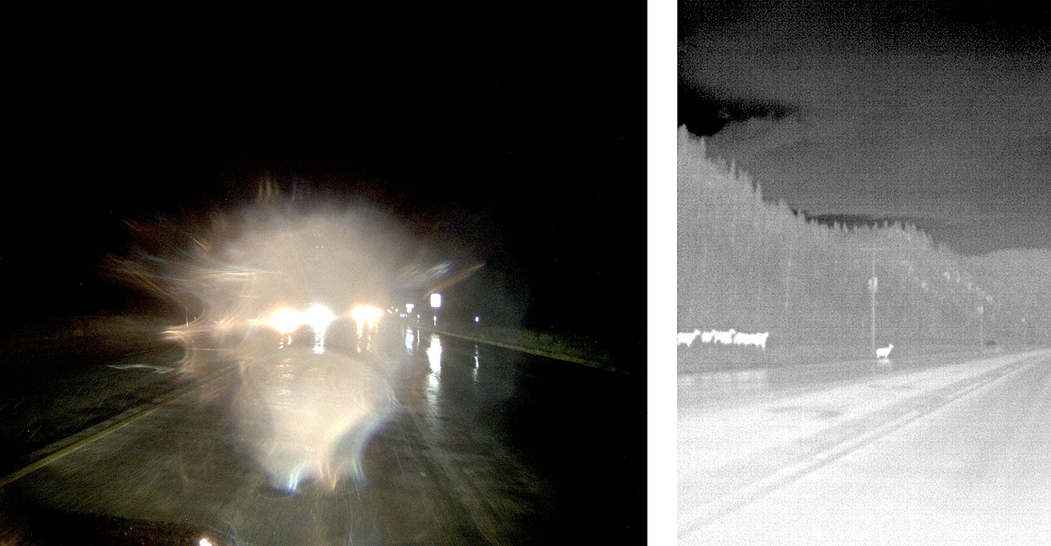
Introduction
Nighttime driving poses significant challenges due to poor visibility and lighting conditions, leading to an increased risk of accidents and fatalities.
The Night Life smart thermal camera (NLSTCC) is a proposed solution to address night driving issues by detecting heat-emitting objects, such as vehicles, people, and animals, using thermal imaging technology. And alert the user, accordingly, enhancing vehicle safety.
Functions as a regular dash camera, recording high-resolution videos that can be accessed through the Night Life application, providing evidence in the event of an accident or other incidents.
Oncoming Headlights Obscure Elk on Rainy Night
Notes:
Each year, there are roughly 260,000 automobile accidents involving wild animals. Our system will drastically decrease these incidents.
We want to create a system that use a thermal car camera that features a powerful thermal imaging system for nighttime driving, which helps drivers detect road hazards in total darkness as well as functions as a regular dash camera. This allows drivers to see pedestrians and wildlife coming regardless of the driving conditions.

Slide 3
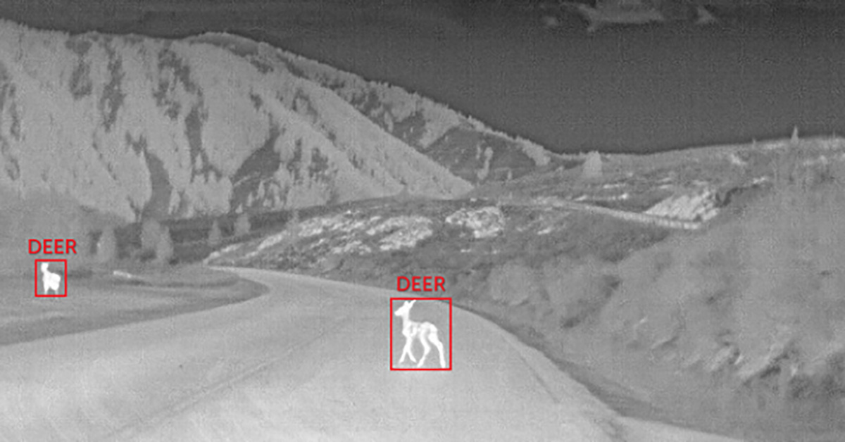
Objectives
To evaluate the effectiveness of the Night Life camera in enhancing vehicle safety during nighttime driving.
Ensure easy access to content recorded by the Night Life camera.
To improve vehicle safety and provide enhanced visibility regardless of light or weather conditions.
Targets audience: long-distance commuters, particularly those in rural areas.
To reduce the risk of accidents and fatalities.
To integrate the Night Life camera system into logistics and courier operations to improve driver safety, reduce accident risks, and potentially shorten delivery times.
Oncoming Headlights Obscure Elk on Rainy Night
Elk Revealed in Thermal Image

Slide 4
Development Process
The (NLSTCC) system was developed based on the software development life cycle (SDLC) model and agile development practices.
The SDLC model: Planning, Analyses, Design, Implementation and Testing
The Night Life application prototype was designed.
User feedback and evaluations were analyzed using an iterative design approach to modify the system design.
Processes: First-time login, connect phone to NLSTCC, Record, Detect road hazard, Upload video feed, Purge videos after 30 days.

Slide 5
Planning Phase
In the planning phase we determined the scope and feasibility of the project, established timeline, identified risks, and ensured the project's smooth progress.
The planning phase was critical in identifying the necessary technical requirements and features required for the camera's successful development, estimating the project timeline and cost, and ensuring stakeholder alignment and involvement.
Notes:
The planning phase is the first stage in the software development life cycle (SDLC) that involves setting up goals, defining strategies, and outlining project requirements.
In the planning phase we determined the scope and feasibility of the project, established timeline, identified risks, and ensures the project's smooth progress.

Slide 6
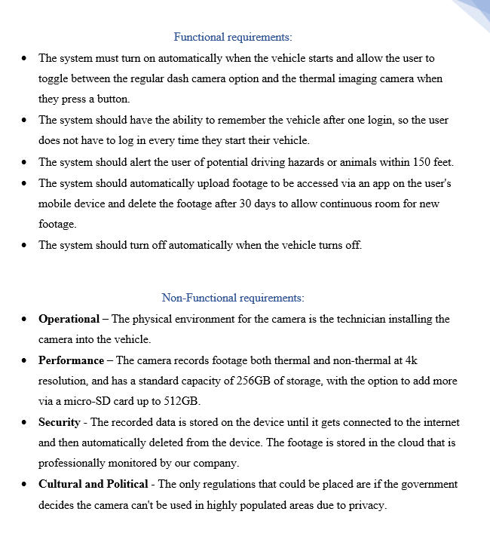
Analyses Phase
Defined system requirements and specifications, analyzed user needs and expectations, identified potential constraints and risks, and created a functional nonfunctional specification document.
The requirements gathering phase involved market research, competitor analysis, and user feedback to ensure the system met user needs and preferences.

Slide 7
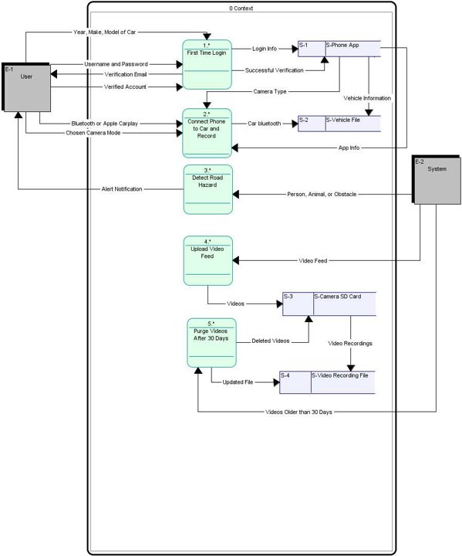
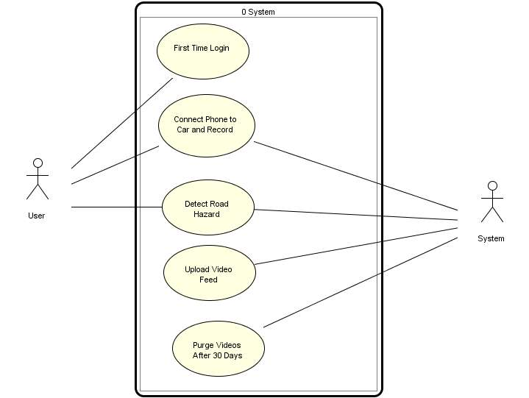
Use case and logical context diagram
Use case diagram
Level 0 Logical Context diagram
Notes:
Analyses Phase

Slide 8
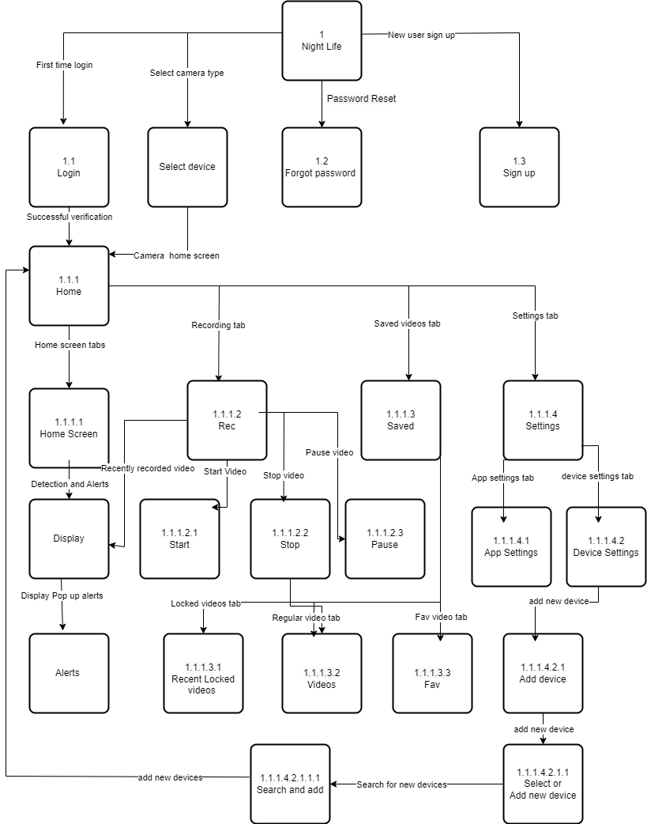
Design
In the design phase, hardware and software components were identified, and a user interface was designed.
The Design phase involved creating various design artifacts, including interface structure design (ISD), Structure Charts, and Data Flow Diagrams (DFDs).
The user interface was designed to be user-friendly and intuitive, allowing users to easily access and customize Night Life's features.
Interface Structure Design (ISD)

Slide 9
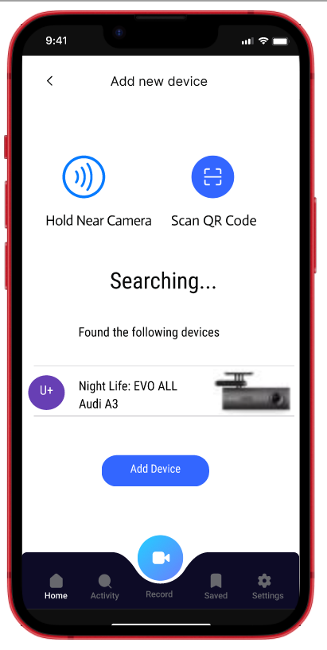
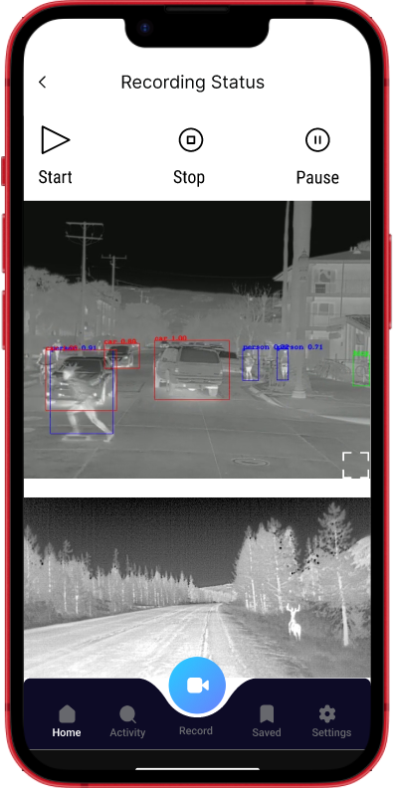
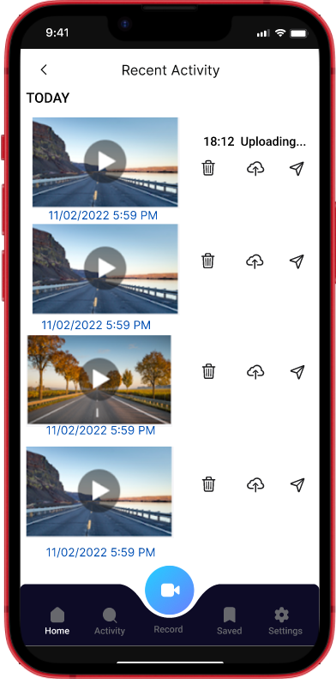
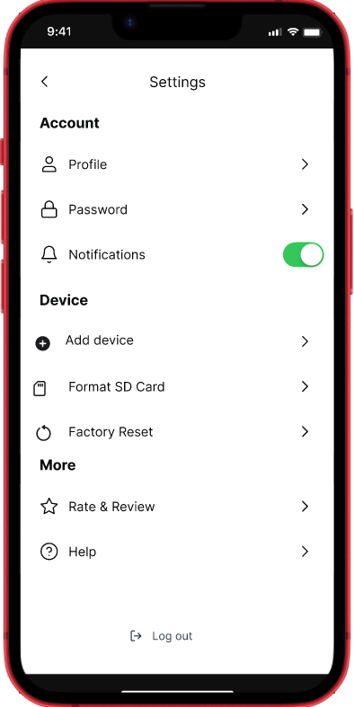
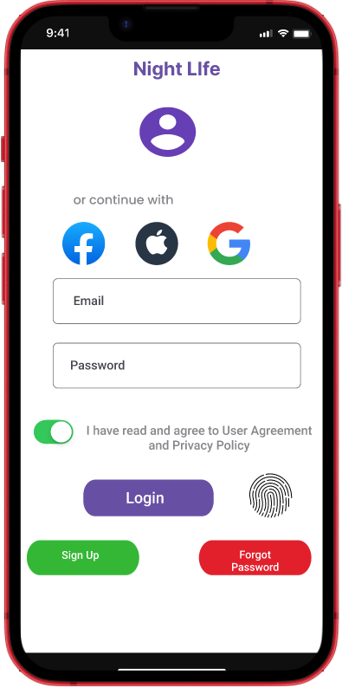
Implementation
In the implementation phase, the Night Life application prototype was designed, and user feedback and evaluation were analyzed to modify the design.
User login
Add device
Recording status
Recent Activity
Settings

Slide 10

Tools and Software Needed to Develop NLSTCC
Hardware Tools:
Thermal imaging sensors: FLIR Lepton, Seek Thermal Compact, Adafruit AMG8833.
Microcontroller: Arduino, ESP32 or Raspberry Pi.
Camera module: High-resolution camera module.
Battery: Rechargeable battery.
Software Tools:
IDE: Arduino IDE.
Programming languages: C++, Python, Java.
Mobile application development platform: Android Studio or Xcode.
CAD software: AutoCAD or SolidWorks.
Notes:
OpenCV, and TensorFlow.

Slide 11
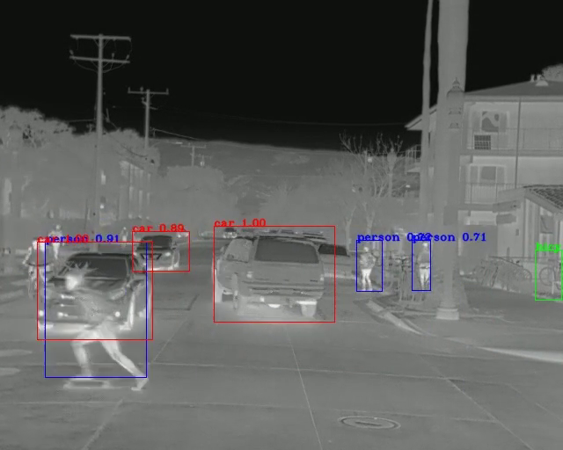
Results
NLSTCC showed promising results in enhancing vehicle safety during nighttime driving.
Positive feedback suggested that the Night Life system's ability to detect potential hazards on the road and alert drivers in total darkness was effective
Dash camera feature was an effective tool for recording high-resolution videos.
System Interface of the NLSTCC received highly positive feedback from users, who appreciated its easy of use, accessibility and intuitive design.
Skateboarder crossing road

Slide 12
Future Directions
Explore the integration of the Night Life camera with other technologies, such as machine learning and artificial intelligence to enhance its capabilities further.
Field studies could be conducted to evaluate the Night Life camera's effectiveness in real-world driving situations.
Explore NLSTCC's potential for enhancing delivery safety during nighttime for logistics and courier drivers.

Slide 13


interface design Demo
Night LIfe

